Slide 1
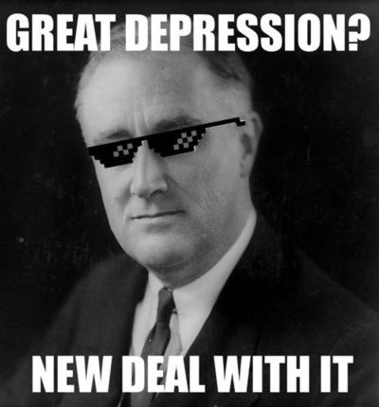
Roosevelt and the New Deals
The Great Depression 1929-1939

Slide 2
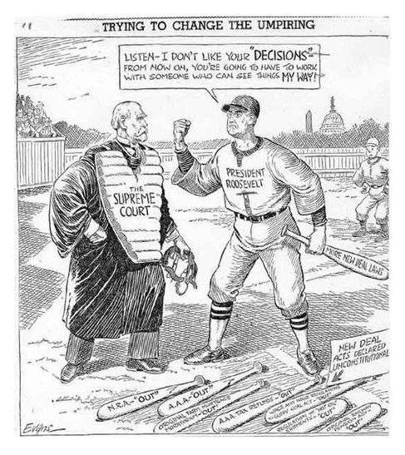
Who opposed Roosevelt and the New Deals?

Slide 3
Opposition to the New Deal
The Supreme Court
From 1933 to 1936, FDR encountered legal obstacles to parts of his New Deal
The Right
Argued FDR’s measures went too far toward people relying on welfare
The Left
Argued FDR’s measures did not go far enough

Slide 4
Opposition
People believed the New Deals interfered too much in peoples’ lives.
The rich
Resented having to pay higher taxes to support works of the New Deal agencies.
Bitter Roosevelt had taken some of their power.
Businesses
Business leaders didn’t like government interference in their affairs.
Angry about Roosevelt’s support for trade unions.
1934 formed Liberty League to oppose the New Deal.
Republicans
Believed Roosevelt was behaving like a dictator, making government too powerful.
Compared to Hitler and Stalin.

